Slide 1
Discussion 9
Disjoint Sets, (Balanced) Binary Search Trees, Hashing

Slide 2
Announcements
Homework 2 due Wednesday, March 14
Homework 3 due Monday, March 19
Midterm 2 on Tuesday, March 20
Midterm review session Friday 16th 8-10 PM
Guerrilla section Saturday 17th 12-2 PM

Slide 3
Disjoint Sets
Data structure that keeps track of whether or not elements are connected
Two basic functions:
connect(a, b)
isConnected(a, b)

Slide 4
Implementations of Disjoint Sets
Quick Find
Quick Union
Weighted Quick Union

Slide 5
Quick Find
Use an array to store which set each element is in
{ 0, 1, 2, 4 }, {3, 5}, {6}
0
1
2
3
6
4
5
int[] id
0 | 0 | 0 | 3 | 0 | 3 | 6
Notes:
Talk about how connect and isConnected work

Slide 6
Quick Union
Use an array to store the parent of each node
int[] parent
0 | 0 | 1 | 3 | 0 | 3 | 6
0 1 2 3 4 5 6
0
1
3
6
4
2
5
Notes:
Talk about how connect and isConnected work

Slide 7
Weighted Quick Union
Quick Union, but always add smaller tree to larger tree
connect(3,8)
0
0
6
1
2
3
4
5
6
1
2
3
4
5
7
8
7
8
9
9

Slide 8
Weighted Quick Union with Path Compression
When you call find (recall that union calls find as well), as you traverse to the root, reassign every node’s parent to the root. (Each node on path to the root should be reassigned)
find(10)
6
6
7
8
7
8
9
10
9
10

Slide 9
Disjoint Set Runtimes
*Technically inverse ackermann function (in lecture), but pretty much constant
Implementation | Constructor | connect | isConnected
QuickFindDS | Θ(N) | Θ(N) | Θ(1)
QuickUnionDS | Θ(N) | O(N) | O(N)
WeightedQuickUnionDS | Θ(N) | O(log N) | O(log N)
^ with Path compress | Θ(N) | O(1)* | O(1)*

Slide 10
Binary Search Tree
Every key in the left subtree is less than X’s key
Every key in the right subtree is greater than X’s key
dog
bag
flat
alf
cat
elf
glut
Binary Search Tree

Slide 11
BST Runtimes
Shape of Tree | Height | add | search
“Bushy” (Best Case) | logN | Θ(logN) | Θ(logN)
“Spindly” (Worst Case) | N | Θ(N) | Θ(N)
Notes:
I think the search runtimes need to be best case/worst case for each tree (i.e, for a bushy tree, search is theta(log N) in the worst case)

Slide 12
2-3 Tree
BST where a node can have 2,3 children
Ensures tree is “bushy” -> height is log(n)
m q
e
o
s u
b
g
n
p
r
t
v

Slide 13
Insertion Example (2-3 Tree)
2-3 Tree after inserting “s”
m
m
e
o
e
o q
b
g
n
p q s
b
g
n
p
s

Slide 14
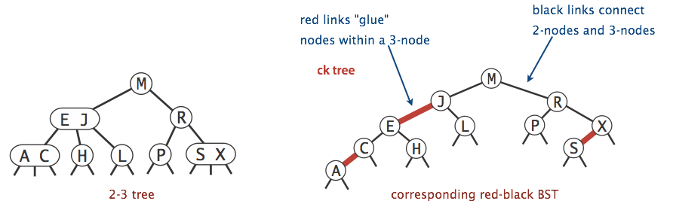
LLRB Tree
Properties of a 2-3 tree, but implemented like a BST

Slide 15
Hashing
Function that produces an integer from a Java object
Properties:
The hashcode for the same object should always be the same
If two objects are “equal”, they have the same hashcode

Slide 16
Hashtable
Use the hashcode % array.length to index into an array
On collision, one resolution is external chaining
0
1
2
3
4
5

Slide 17
HashTable Runtimes
 | add | get | remove
Best Case | Θ(1) | Θ(1) | Θ(1)
Worst Case | Θ(N) | Θ(N) | Θ(N)

Slide 18
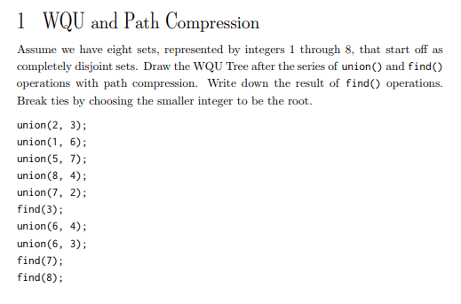

Slide 19
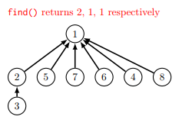

Slide 20
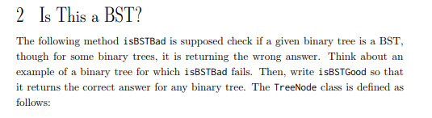

Slide 21
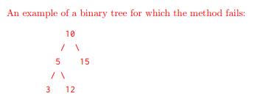

Slide 22
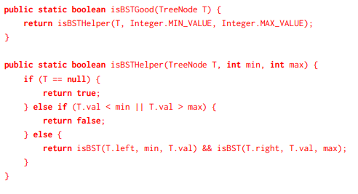

Slide 23
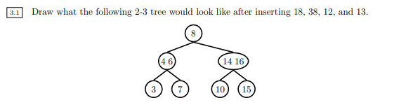

Slide 24
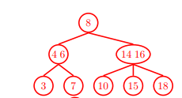

Slide 25
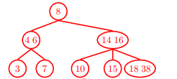

Slide 26
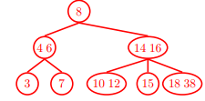

Slide 27
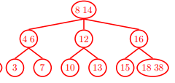

Slide 29
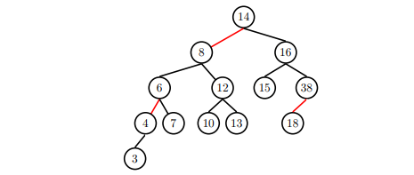

Slide 30
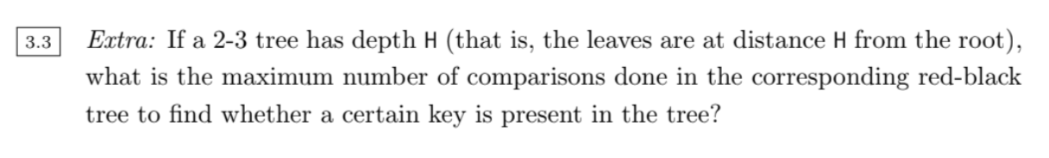

Slide 31
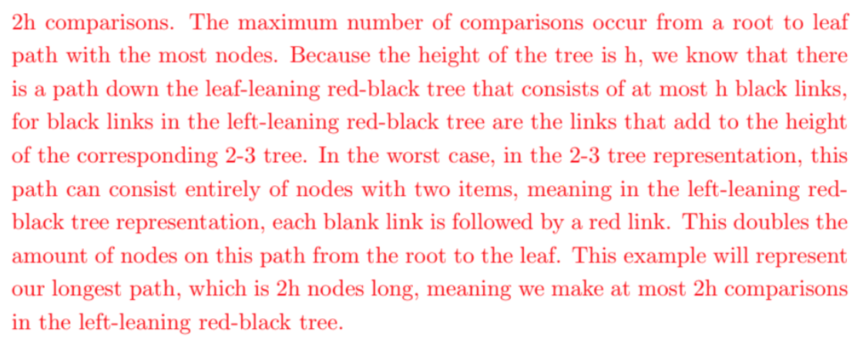

Slide 32
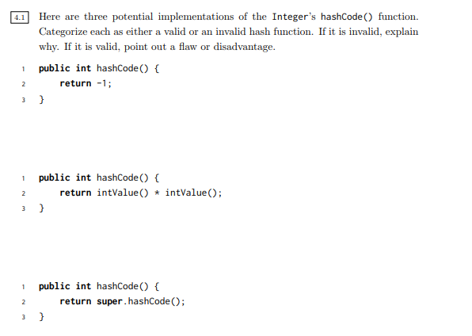

Slide 33
